Slide 1
Basic test concepts
J. M. Martins Ferreira
FEUP / DEEC - Rua Dr. Roberto Frias
4200-537 Porto - PORTUGAL
Tel. 351 225 081 748 / Fax: 351 225 081 443
(jmf@fe.up.pt / http://www.fe.up.pt/~jmf)

Slide 2
Objectives
To emphasise the importance of testing in the overall product development cycle
To introduce the basic concepts in testing and test vector generation

Slide 3
Outline
Fault modeling and ss@ faults
Controllability, observability and testability
Test vector generation for combinational circuits
Redundancy and undetectable faults

Slide 4
The importance of testing
No testing, no manufacturing
Cost of testing is very high, but the cost of defective testing strategies is even higher
Available test standards
A brief historical perspective

Slide 5
Why fault models?
Possible physical defects are too many and defect spectrum too wide
Effective test strategies require that the complexity of malfunction models is reduced to an acceptable level
Fault models are an abstract representation of defective circuit conditions (a fault is at logic level, a defect is at physical level)

Slide 6
Attributes of a good fault model
Simplicity, to allow efficient test vector generation procedures
Defect coverage, to guarantee that the percentage of defective components escaping detection is acceptably low

Slide 7
The single stuck-at fault model
A structural fault model assuming that
  Only one node at a time is faulty
  Only two types of faults: s@0 and s@1
Experience has shown that the ss@ fault model has excellent characteristics concerning those attributes that were previously referred

Slide 8
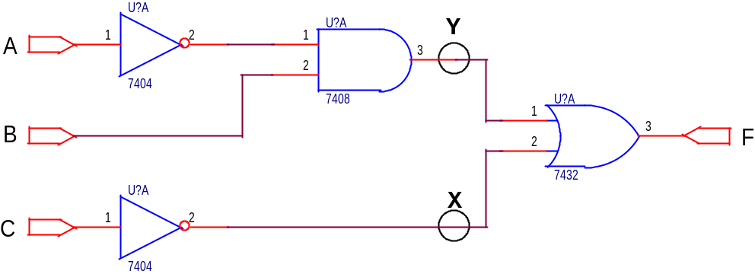
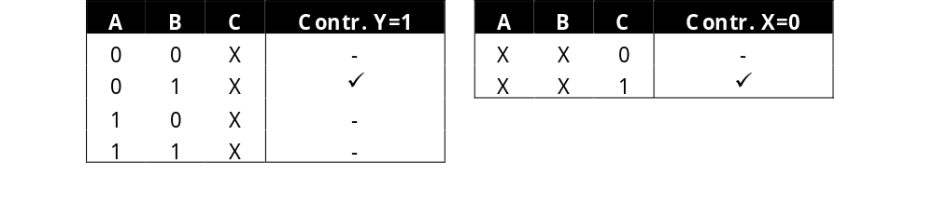
Controllability of a node

Slide 9
Problems due to low controllability
Low controllability leads to difficult test vector generation, since:
  Our first step to detect a given s@ fault in a node consists of driving it to the opposite logic value (1 if s@0 or 0 if s@1)
  In an IC, the value at any node can only be controlled from the input pins (the primary inputs of the circuit)
Low observability, as we shall see, has a similar effect

Slide 10
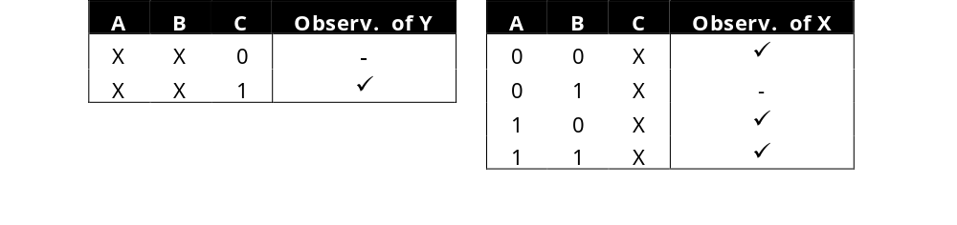
Observability of a node

Slide 11
Testability
Testability is a combined measure of controllability and observability
High testability facilitates test vector generation and leads to better test effectiveness
So, why aren’t all circuits highly testable?

Slide 12
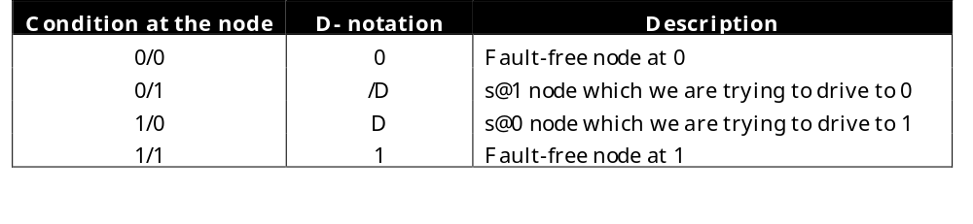
The D-notation
Introduced by Paul Roth in the mid-60s for the (test vector generation) D-algorithm
D is a composite logic value that results from driving a s@0 node to 1 (and /D its dual)

Slide 13
The D-algorithm
Drive the node to the opposite logic value (0 if s@1 and 1 if s@0)
Propagate the error signal (D or /D) to a primary output
Justify (backwards) the values that enable the propagation path, until a necessary combination at the primary inputs (a test vector) is found

Slide 14
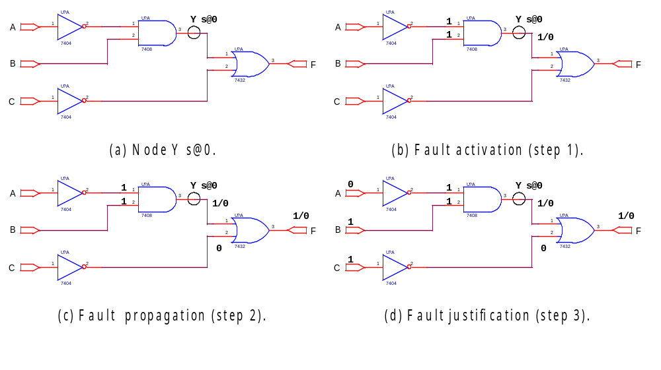
A test generation example

Slide 15
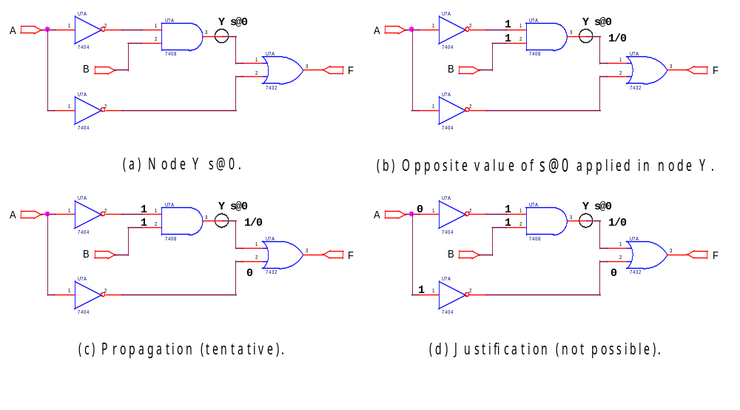
The case of undetectable faults

Slide 16
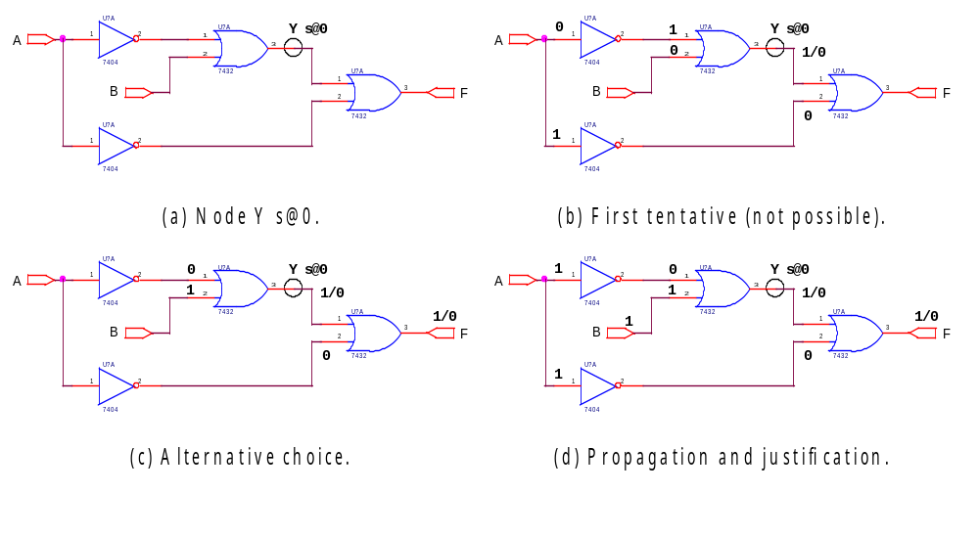
Backtracking

Slide 17
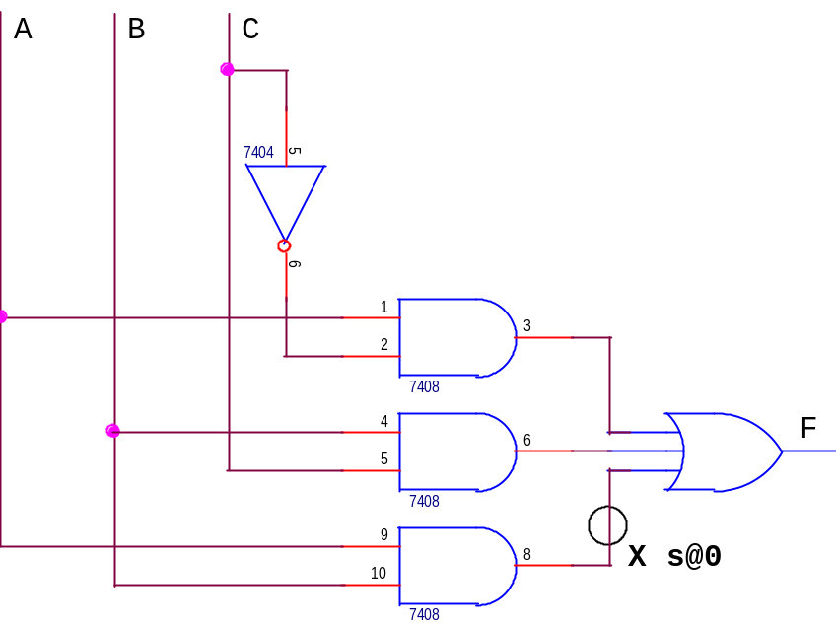
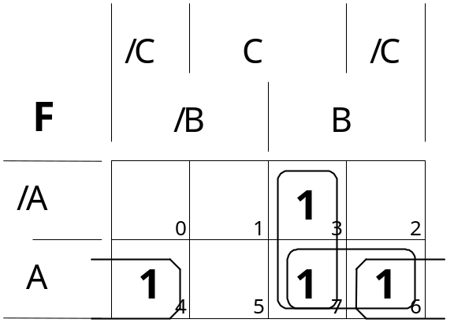
Redundancy and undetectable faults
Redundant product terms degrade testability for the same reason that they may introduce fault tolerance features (ability to mask faults)

Slide 18
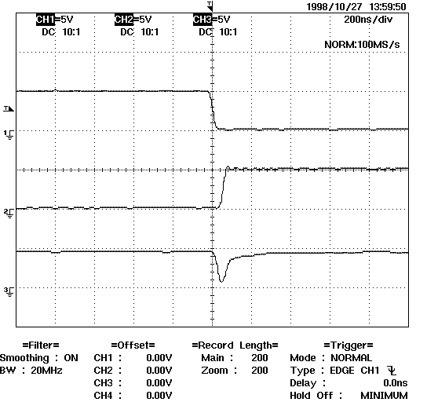
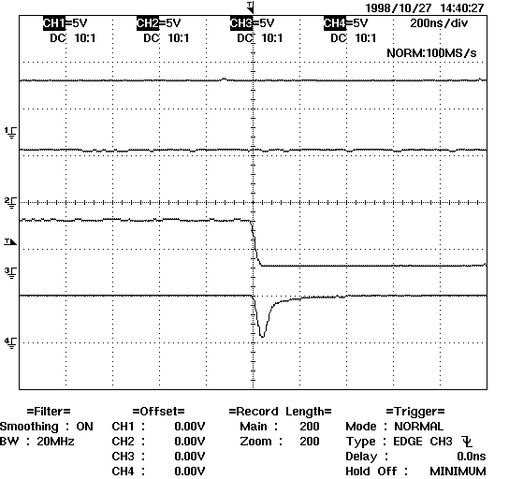
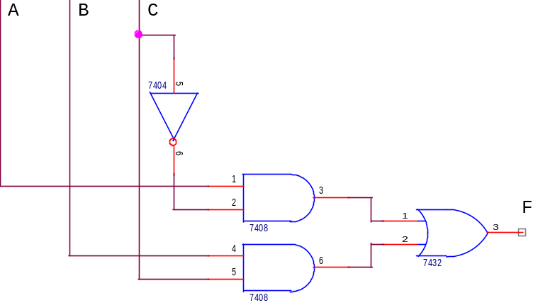
But are those faults really undetectable?
Redundancy may be used to avoid glitches (correct transient behaviour), which may be visible again if faults are present

